Slide 1

Accounting Hub An Overview

Slide 2
Agenda
ACH – Technical Introduction
Payments Ecosystem
TMH and ACH in LBG
Way forward

Slide 3
What is the Accounting Hub?
Accounting Hub is the single entry point between payment engines and channels to the accounting product platforms for:
Account postings
Informational requests/balance enquiries
It hides complexities like
Accounting Model
Product platforms
Message formats and protocols
Aggregation
Platform availability

Slide 4
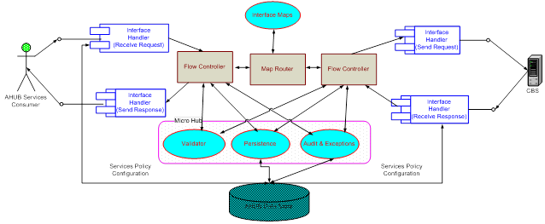
Architecture Pattern
The Microkernel architectural pattern applies to software systems that must be able to adapt to changing system requirements. It separates minimal core functionality and customer-specific parts. The microkernel also services and a socket for plugging in these extensions and coordinating their collaboration

Slide 5
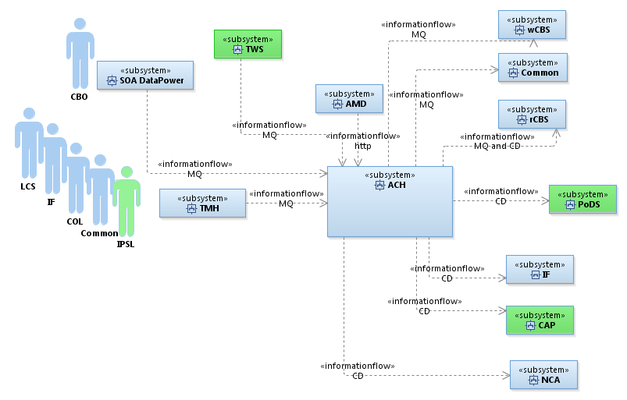
Overview Diagram

Slide 6
Platform Features
Configurable accounting model that, enables it to connect & post the transactions over MQ (Online) or C:D (Batch) either as a single/collated batch/aggregated amount posting, to the right account product platform.
Can enable stand-in feature which, incorporates the ability to hold postings within ACH when account product platforms are unavailable.
Pro-active alerts, Auditing, Logging, Archiving

Slide 7
Accounting Hub Benefits
Decouples the accounting knowledge from the Payment Engines
Reducing complexity on Payment Engines
Accounts can be migrated between product platforms without any changes required to the Payment Engines.
Standardise the accounting models and settlement processes. Consolidation of all postings reduces overhead to introduce changes

Slide 8
Account Posting Service - Online
Consumer
ACH
Provider
Receive Request
Validate Message
Persist
AMD Mappings
http
AMD
(Account Master Database)
MQ
4
5
Converts to IFW format
Get additional account info & Get Posting Details
3
2
6
DB2
TMH
IFW Response Mappings
Platform Mappings
MQ
Generic Gateway
OpenMax
RCBS
MQ
9
8
7
1
Payment Engine

Slide 9
Payments - UK
CHAPS
There are around 1.1 million CHAPS payment of value approx. £630Bn on an average per month.
RTGS
BACS
FPS
ICS
International

Slide 10
Payments Systems - Utopia
Channels
Gateways
Unified Payment Engine
Universal Product Platform

Slide 11
Payments Systems - Reality
Channels
COL
Loli
Gateways
CPH
EBS
Galaxy
SOC
Stelink
ACI
Payment Engines, e.g.
LCS (CHAPS)
Common (International)
STP
(FPS, BACS)
Gateways (Outbound), e.g.
LTSB Product Platforms
HBOS Product Platforms
Stelink
ACI
NCA
IF MIDTIER
WBCS
CBS
CAP (VIA BNS)
Common

Slide 12
Payments Systems - Vision
Channels
COL
Loli
Gateways
CPH
EBS
Galaxy
SOC
Stelink
ACI
HBOS Product Platforms
Additional capabilities
Sanctions Checks
Anti Money Laundering
MI & Reporting
Exceptions and Investigations
TMH
TODS (Data Store)
Transaction Bus
Accounting Hub
Payment Engines
Gateways
LTSB Product Platforms

Slide 13
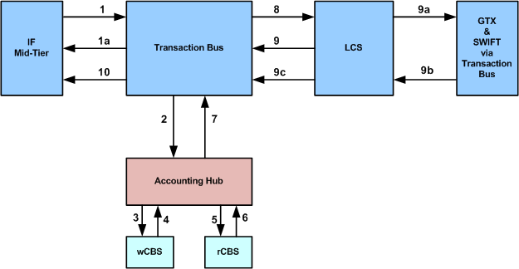
TMH & ACH In Action
IF Mid-Tier CHAPS payment E2E flow
1. IFM sends payment message to TxnBus
1a. Invalid payment - response from TxnBus
2. APS Request to Accounting Hub
3. Account Posting Request to wCBS
4. Account Posting Response from wCBS
5. Account Posting Request to rCBS
6. Account Posting Response from rCBS
7. APS Response from Accounting Hub
8. Payment message (B11) to LCS
Note: IF corporate accounts are present in wCBS.
9. LCS sends N31/R90/S11 to TxnBus
10. Response from TxnBus to IF Mid-Tier
9a. Outbound payment to GTX & SWIFT
9b. Response from GTX & SWIFT
9c. LCS sends S11 (if applicable) to TxnBus

Slide 14
Complex Accounting Model
ICS: In-Clearing/Credit - Aggregated Transactions Credits (NCA) - Internal Dept (CRE)
Platform | Mode | Agg | Agg Type | Acc Desc | Description
NCA | Batch | AGG | IBC | - | Normal Inclearing Credit flow to Internal Dept in NCA. This entry will get aggregated to AMD_27 Note: AMD_46 will get generated to balance the O/C and I/C RTP NPA for this txn
rCBS | Online (Agg) | AGG | IBC | ISA | Inclearing Credit to NCA ISA This entry will get aggregated to AMD_27.1
rCBS | Online (E596) | AGG | IBC | NPA | This is needed to provide single aggregated entry to Internal Dept Credits Settlement account and O/C NPA. This entry moves money from I/C NPA to O/C NPA to adjust the NPA accounts. ACH: Will aggregate and post this, ∑(AMD_90: I/C NPA)
PODS | Batch | AGG | LST | IBC | AMD will generate an additional accounting entry which will allow ACH to provide transaction listing to Hadoop. This is for the listing to happen back of Internal Department Credit aggregation. ACH has to do match and drop (CRE & CNP) of transaction to match the netting done using the posting type.

Slide 15
Development Methodology
End to end delivery responsibility
Agile - Short development cycle, Iterative, Scrums and Backlog
Continuous Integration
Quality focus
One Team
Risks

Slide 16
Deliveries and Way Forward
Since IBM took over (last 3 yrs)
Upcoming Changes (Planned)
CHAPS Resilience
International Payments
Image Clearing Scheme
Ring Fence Bank
SCAR
CMP
Aurora Cloud Migration
DevOps

Slide 17
Thank You

Slide 18
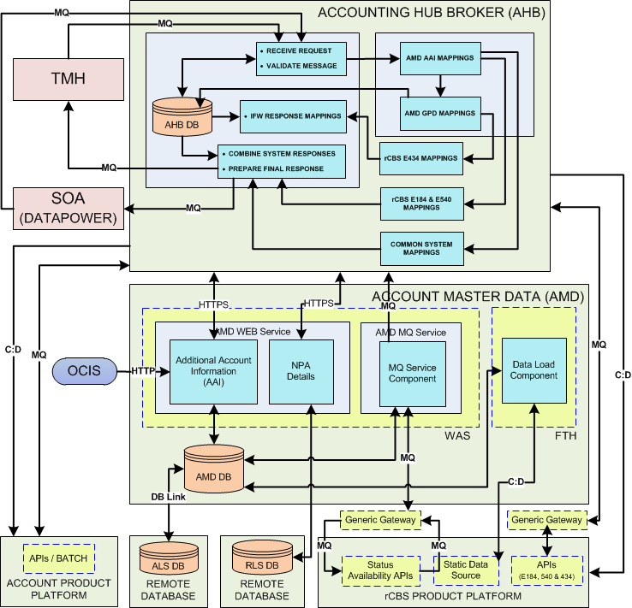
Platform Architecture

Slide 19
Account Posting Service Batch
Consumer
ACH
Provider
Receive Request
Validate Message
Persist
http
AMD
(Account Master Database)
MQ
AMD Mappings
4
5
Converts to IFW format
Get additional account info & Get Posting Details
3
2
6
DB2
TMH
TMH
IFW Response Mappings
Platform Mappings
MQ
MQ
12
9
8
7
10
1
Batch Monitor
11
Payment Engine
Product Platform

